Slide 1
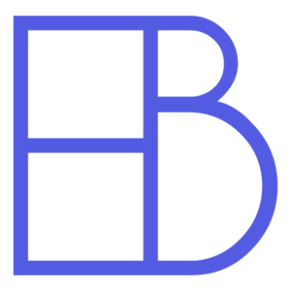
Electric Blocks
Concept Design Review
Notes:
Simple welcome

Slide 2


Zach Sugano
Computer Science
Project Lead
Christian Whitfield
Computer Science
Communication and Documentation Lead
Wiki Master
Notes:
Hey I’m Zach, I’m a senior studying computer science and my role is project lead. I am joined today by Chris
Chris introduces self.

Slide 3

Project Overview
Concept Design Process
Risks and Validation
Project Management
Current Project Status
Notes:
Concept design review is a formal progress update which will cover the topics listed here.
Project Overview: Get to know what project is about by discussing Objective, Background, Requirements, and Value Proposition
Concept Design Process: Summary of our background research and major design decisions and recommendations
Risks and Validations
Project Management: Budget and schedule and how our project will work within constraints
Current Project Status: Demonstrate our working prototype
We will then open up for questions at the end.

Slide 4
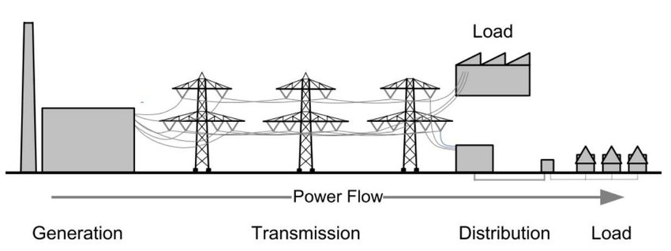
Project Objective
Enable the creation and use of realistic and accurate virtual reality models of electric power transmission, distribution, control, and usage scenarios for research and instruction purposes.
Notes:
What is the objective of Electric Blocks?
This was the objective statement given by our client.
Everyone here is using electrical power to attend presentation. Most people don’t think about how this. Electricity is ubiquitous and taken for granted.
But not by electrical and power engineers. They must carefully design complex systems for power delivery.

Slide 5
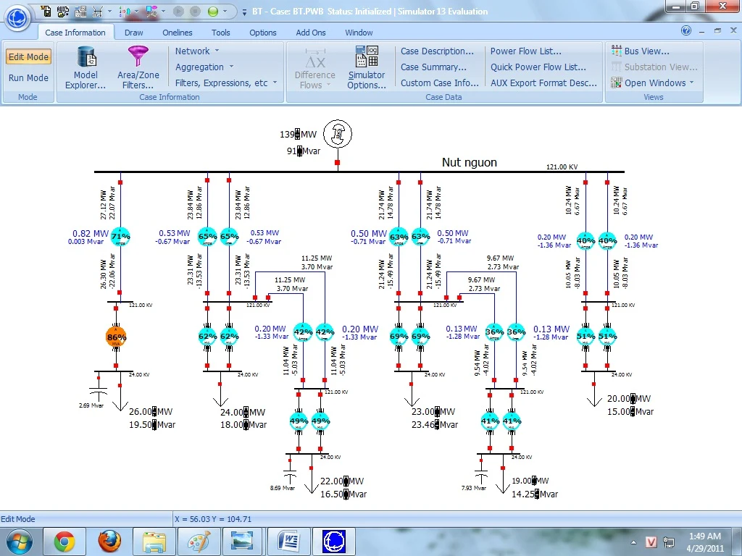
Notes:
To do this, power engineers might use software like this. This is a Screenshot of Popular commercial software PowerWorld.
Clean visual interface with network organized in a clearly labeled hierarchy. The software has a variety of buttons for performing various tasks.
Network diagram contains rated voltages, active and reactive power, as well as the percent load at important locations.

Slide 6
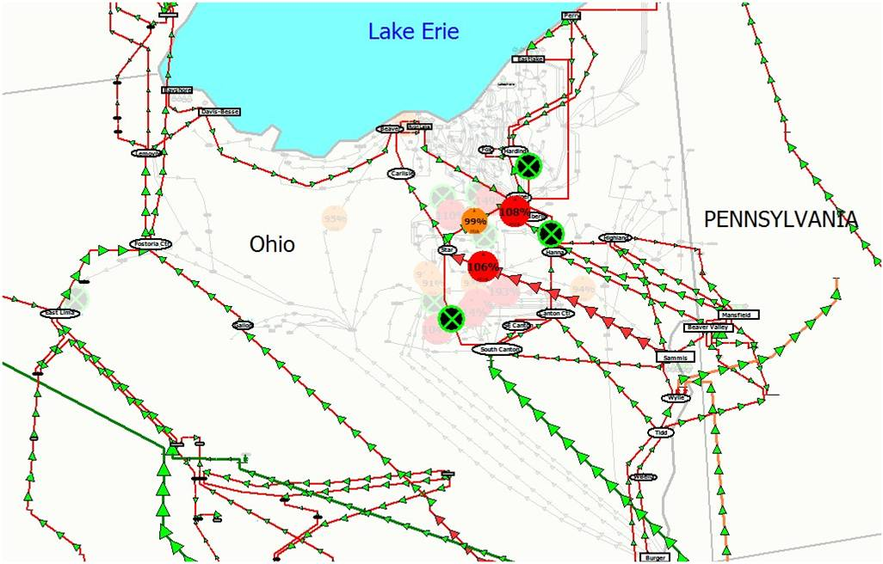
$11,000
Notes:
Overlay network on real world map so they can see the macroscopic activity of where power is going and spot potential problem areas ahead of time.
So it looks like this problem is already solved and we can conclude this presentation.
But not so fast. *CLICK TO DISPLAY COST*. This commercial software costs $11,000 for a single license. This isn’t a team license, that is just for one single computer. Pricing not reasonable for research and instruction. I’m a student and when you’re eating ramen for dinner, you aren’t going to drop $11,000 dollars on a software license. Well there must be a free alternative right?

Slide 7
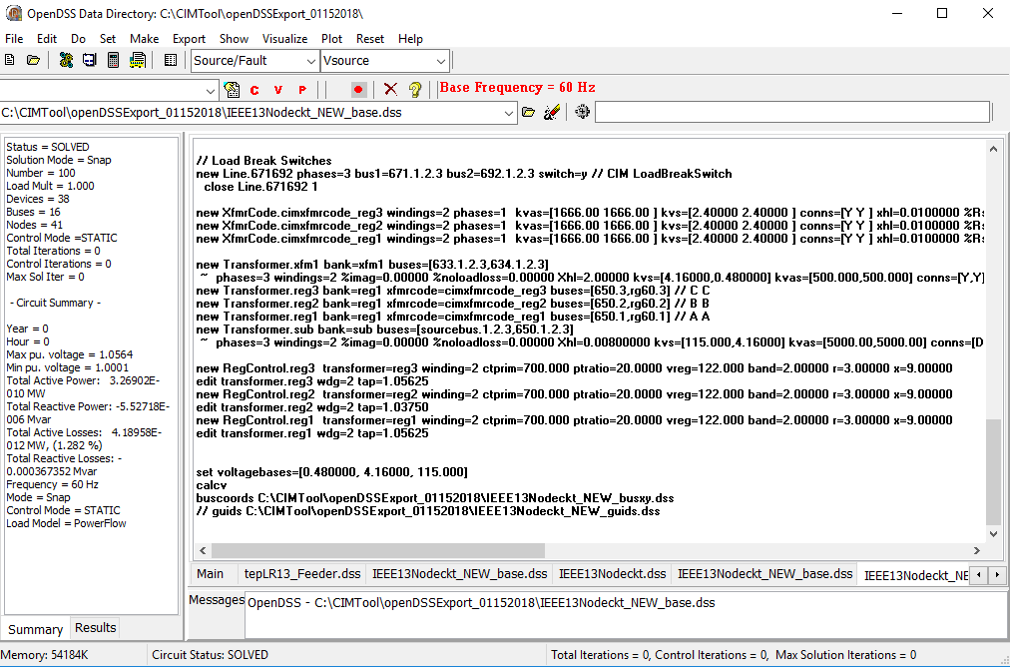
Notes:
And you would be right. This is a screenshot of OpenDSS which is a completely free and open source power distribution solver and simulator.
This is free, but you have to enter many lines in a complex scripting language. This looks a lot less intuitive than our previous option. If you were just starting to learn how power distribution works, you would probably be a bit overwhelmed by this.

Slide 8
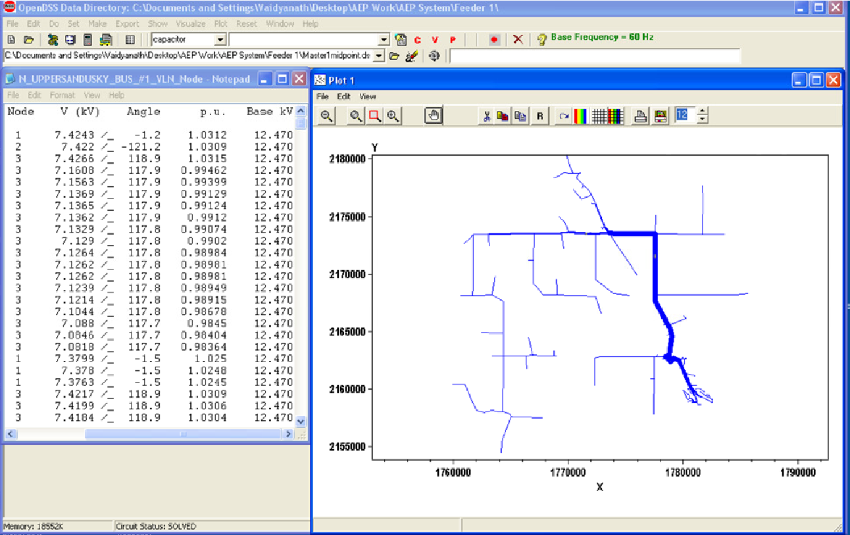
Notes:
Unlike the commercial software, you really don’t get a pretty interface for this one. Interpreting these results can be a challenge all on it’s own.
Our client didn’t want to choose between ease of use and cost. He wanted a system that was easy to use, completely free, and as intuitive as building with legos… or perhaps blocks. This is where Electric Blocks comes in.

Slide 9
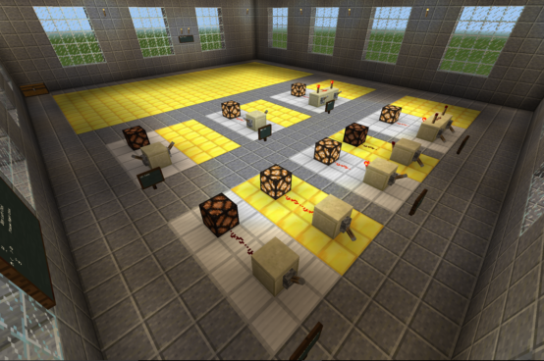
Notes:
Our client wanted to merge power flow simulation software with the simplicity of a block based world like Minecraft.
Minecraft is already used as a powerful educational tool for teaching digital circuits. This image shows several simple logic gates here, but...

Slide 10
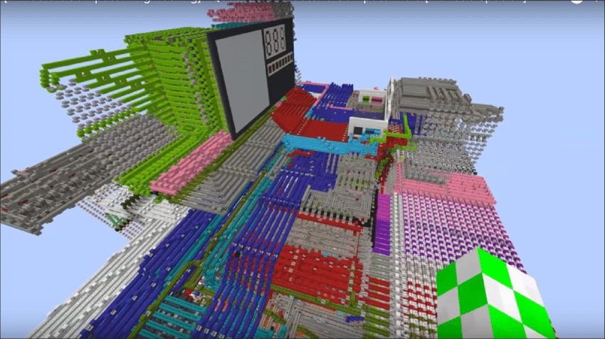
Notes:
By connecting these simple circuits together, you can simulate just about any circuit you want.
This image features an 8-bit quad core programmable computer constructed entirely in minecraft. Use cases like this inspired us and our client to apply these same principles to power flow simulation.
Before we could start on this though, we needed to clearly define our product requirements. *PASS OFF TO CHRISTIAN*

Slide 11
Product Requirements
Accurately model and simulate power flow
Easy to use
Interactive and Collaborative
Completely free and open source
Notes:
With all this information in mind, we used our objective to develop requirements for this product. Starting with the obvious *Click*
It must be accurate and feature rich enough that it could be used for real world engineering applications. There is plenty of existing software that can do this.
It must be easy to use. It needs to be so easy to build a basic circuit that anyone could do it with minimal assistance.
Voltage and wattage values don’t give an intuitive understanding. Meaningful feedback is important and they need to be able to work on circuits with others in real-time.
It needs to be completely free and open source. Parents and taxpayers already spend massive amounts of money on education and research. All you need is a computer to get started.
*PASS BACK TO ZACH*

Slide 12
Value Proposition
Lower barriers to entry
Improve education
Allow for rapid prototyping
Improve collaboration
Notes:
Developing a product that meets these requirements would provide great value to users and solve several real world issues.
Power engineering is not an easy discipline to learn, but our software could make it dramatically easier for anyone to start learning.
Electric Blocks could provide an interactive and exciting way for students to gain an intuitive understanding of difficult concepts.
Rather than spending time writing scripts and diagrams, engineers and researchers could just load up Electric Blocks and start prototyping.
Offer the first real-time collaborative platform for power flow engineering.
Our project is focused on delivering a working proof of concept, but we believe our system or one based on it could greatly improve power flow engineering.

Slide 13
Project Overview
Concept Design Process
Risks and Validation
Project Management
Current Project Status
Notes:
Now that you understand what our project is about, we will summarize our research and design approach.

Slide 14
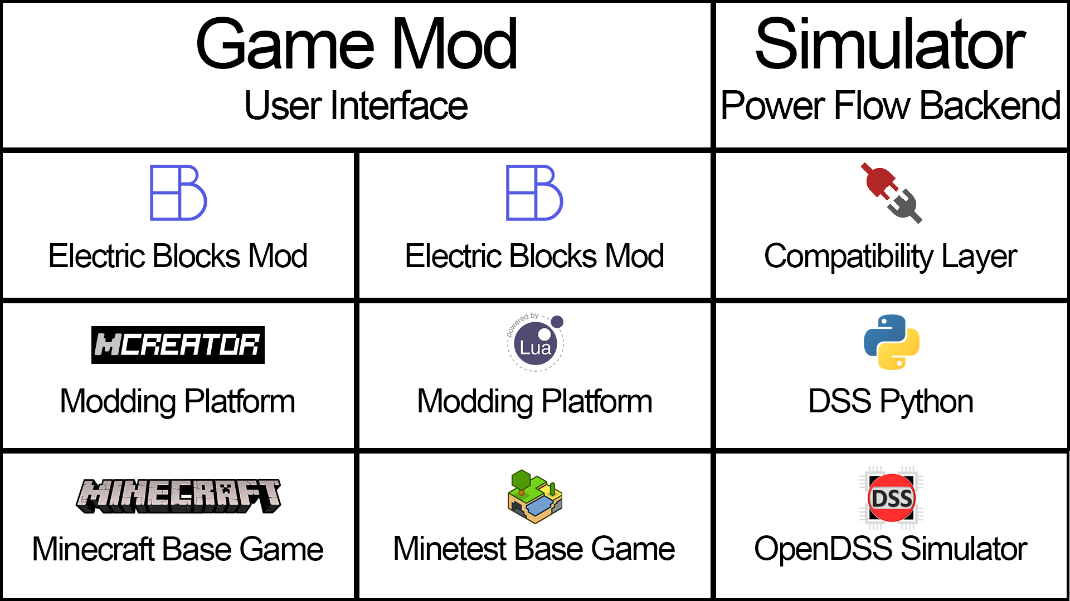
Notes:
Client gave us design idea foundation. Image shows technology stack recommended.
Focus on right. Key requirement is real world accuracy so client emphasized not to make our own simulation software. Use pre-existing validated software.
Focus on the two left hand columns. Choice between two base games, but either way produce mod that interacts w/ simulator.
Simulators were not written in same language as either modding platform, so 2 pieces of software were ultimately needed. The mod itself, and a compatibility layer for communication between mod and simulator.
Now Christian is going to explain how we took this initial design and shaped it to best meet our projects goals.

Slide 15


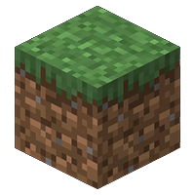
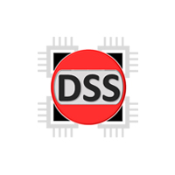
?
?
?
Notes:
This is a minimal version of the previous tech stack. Now we had a general idea for how we would approach project, but we still had many questions that we needed to answer.
*CLICK* How exactly would our mod communicate with the compatibility layer?
*CLICK* How would our mod translate game state information into a simulation request? How would our mod update the game state once a simulation had been completed?
*CLICK* And how would the simulator listen for a request and communicate the results back through the compatibility layer to the mod?
That was just a small sample of some of the questions that we needed to answer before this project could be realized.

Slide 16

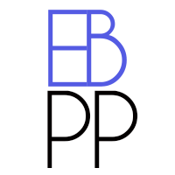



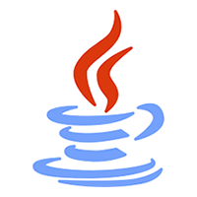
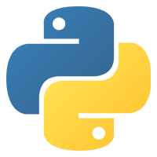
Notes:
We will not have time to discuss the answers to all these questions in detail, but I will cover some of the design decisions we made. This image shows the current technology stack that we are using and we recommend that we continue to use it. We will start with the left hand column.
We decided early on to use Minecraft: Java Edition as our base game. Minecraft has over a hundred million active players and is one of the most popular video games of all time. We wanted to target this large player base as our potential audience. Alternatives are much more obscure and would be less likely to capture the attention of children and young adults.
We also decided to develop our mod using the Forge modding platform. This software library is the defacto standard for mod development. This platform is familiar to players and other mod developers, making it the clear choice.
Moving over to the right hand column. Here we ended up deciding to use a library called PandaPower instead of OpenDSS as the power flow simulation software. We felt this was necessary for a variety of reasons. PandaPower is pure python and has much better cross-platform support making it much easier to install. PandaPower also features a more complete library that makes building an electrical network much easier.
PandaPower handles the actual simulation, but we need a way to communicate between these technology stacks. We decided to use Flask for this task. Flask is a micro web framework that handles handles HTTP requests. It’s like a boiled down Django, for those of you who are familiar with Django. Using a web server to connect the mod to the simulator has many benefits. The most important one is the ability to run the mod and the simulator on different machines. PandaPower simulations can be CPU intensive and many people don’t have a modern high speed computer to run both a game and simulations on simultaneously.
At the top of our simulation stack is Electric Blocks PandaPower or EBPP for short. EBPP uses Flask and PandaPower to parse incoming simulation requests, perform the simulation, and send the results back to ElectricBlocks. All requests are all formatted using JSON.
*PASS BACK TO ZACH*

Slide 17
Project Overview
Concept Design Process
Risks and Validation
Project Management
Current Project Status
Notes:
Now that you know what approach we think is best, we will cover some of the risks of our design as well as how we will validate that it works correctly.

Slide 18





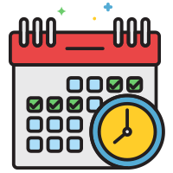
X
X
X
Notes:
Due to the software based nature of our project, our risk profile differs from that of other projects.
*CLICK* We largely don’t need to worry about risks stemming from physical injury, budget constraints, or environmental/societal. Risks in these categories would be considered outside the scope of our project.
*CLICK* We do have other risks that we need to manage such as legal risk, upstream software risk, and scheduling risks.
We are currently permitted to make and release modifications to the Minecraft game under the end user license agreement, but the company that owns Minecraft could theoretically change the terms of this agreement at any time and make it illegal for us to produce or distribute this mod. While this does represent a serious risk to the project, Minecraft has been legally used as a platform for mods for over a decade and we have no reason to believe that they would change this policy for noncommercial mods.
Another risk for this project is the possibility of major changes to upstream source code that we rely on. This applies to both the game and simulation software. Substantial changes could break our code, but fortunately the risk of this is minimal. For the game itself, we have chosen to develop on their long term support platform. Additionally, the project already tries to make minimal changes between versions so that mods can work on many versions. While the simulator could undergo large changes, it is very easy to install a specific version of the software with minimal changes on our part. Thus we believe that upstream source code changes are unlikely to harm the project.
Lastly we have scheduling and project management risk. This simply represents the risk that our team will be unable to meet our requirements within the timeline. To mitigate these risks we have developed a schedule and been holding regular meetings to keep all team members informed of what they should be working on.
Ultimately, we believe that our project has very little risk and will be successful.

Slide 19
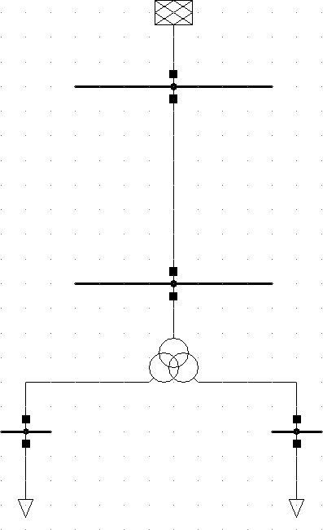
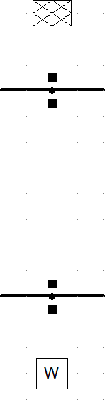
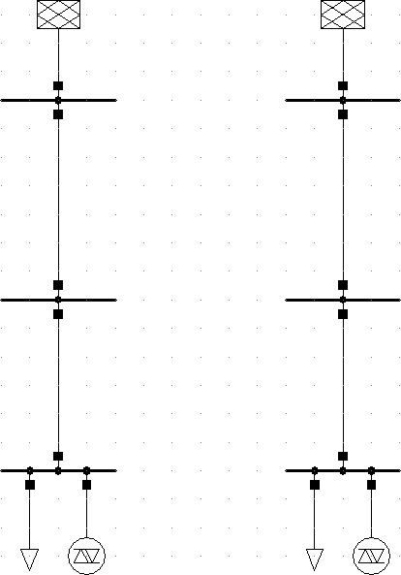
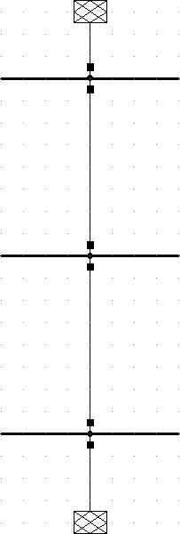
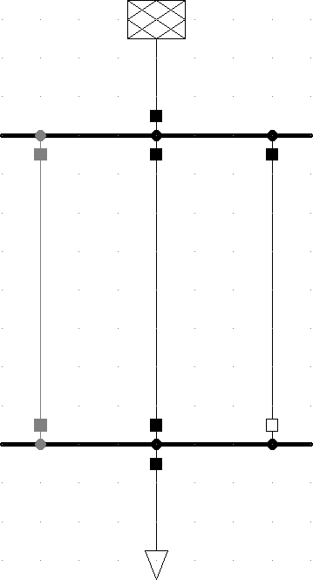
Notes:
Here are a few images of test cases that are used to validate the simulator. The simulator that we are using is already validated to ensure accuracy and so our client has not requested that any additional tests be performed.
However, to ensure that our system is able to accurately model these cases, we plan to recreate a sample of them using our mod and check to ensure the results of our system match the test cases.

Slide 20
Project Overview
Concept Design Process
Risks and Validation
Project Management
Current Project Status
Notes:
Now we will discuss the budget and schedule for our project.

Slide 21
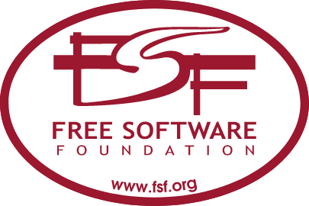

X
Notes:
As we mentioned before when discussing risk, our product has no money allocated towards it. We do not have any current or future expenses and we have designed our project to ensure that we do not incur any expenses.
All software being used for development is free and open source.

Slide 22
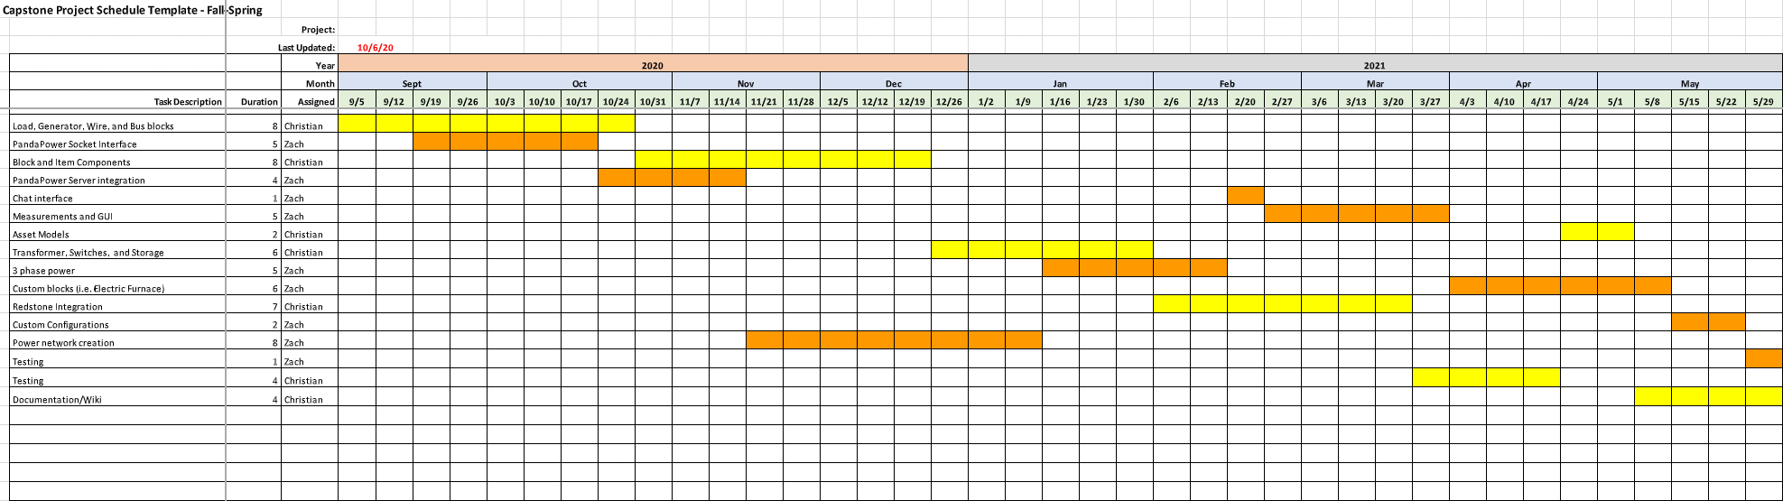
Notes:
We have scheduled this project out in this chart. We have color coded the chart based on who is responsible for each task. We are currently ahead of schedule and we have already completed several tasks. We have already implemented the most basic blocks needed to build the network. The mod is also able to create a socket connection to EBPP, send simulation requests, and update the game state with the resulting information.
While we are ahead of schedule, we still have many features to work on. The next stage of development is going to focus on adding more complex elements like transformers and three phase generators. After that, we want to create a GUI for interacting with electric networks. There is still lots of work to be done, but we are confident that we can remain on schedule.

Slide 23
Project Overview
Concept Design Process
Risks and Validation
Project Management
Current Project Status
Notes:
Before we end this presentation, we are going to give you a brief demonstration of our working prototype.

Slide 24
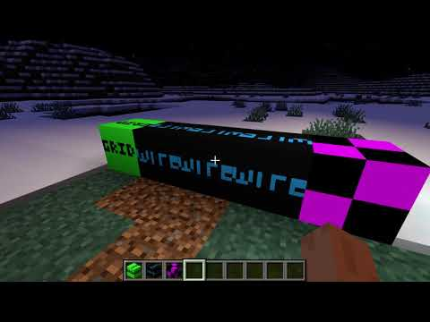
Notes:
*PLAY VIDEO* Here we have Minecraft with our mod and the simulation software running. We have a nice little zombie there and as you can see, it’s pretty dark. To lighten things up, we are going to place down a lamp and right click on it to turn it on.
But it won’t turn on, because it isn’t receiving any power. To fix this, we’re going to place an external grid block and connect it with some wire. You can imagine this green block as representing your homes connection to the power grid.
Now we try to turn on the lamp and success! The lamp is receiving power and lights up. Our system is able to accurately detect connections regardless of path or length. Here you can see the light still works with this indirect path.
If we disconnect it once again, we can see the lamp does not work. The lamp will only work when properly connected.
We have also started work on handling failure conditions gracefully. Let’s try connecting the lamp normally, but also add an invalid loop where the lamp is connected to itself. As you can see, the lamp still turns on and off normally, but notifies the player that the loop they constructed is being ignored.

Slide 25
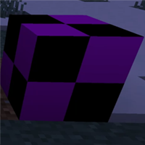
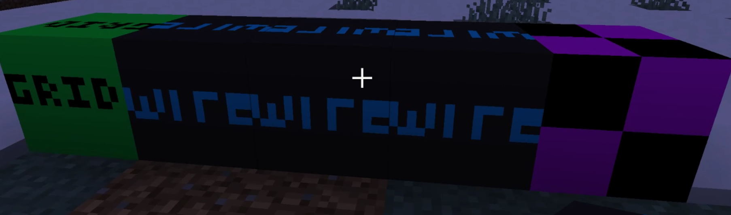
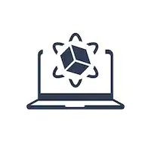
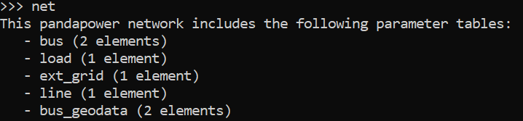
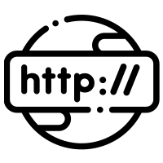
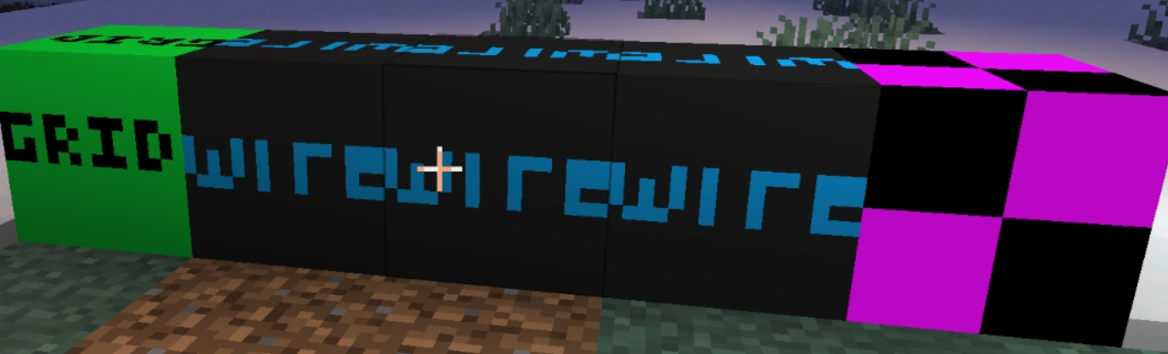
Notes:
Now this may seem like a fairly trivial prototype, but you must not forget what is really going on. This is not just a light turning on and off. Under the hood, thousands of lines of code are required. *CLICK* We start with the unlit lamp block which stores information about the lamp such as its current power usage, max power, and light levels. *CLICK* The mod then detects which blocks are connected to it with wires. *CLICK* This electric network is then converted into a JSON representation.
*CLICK* An HTTP request with that information is sent to the simulation software. *CLICK* The simulation software parses this request and builds an internal model of the electric network. *CLICK* It then runs a power flow simulation.
*CLICK* Our code then parses the results and forms a JSON response. *CLICK* The response is sent over the network back to Electric Blocks. *CLICK* Our mod then parses this result and updates the in game state to accurately reflect the simulation results. *CLICK* And finally we have our lamp turned on. The flipping of a light switch toggles a cascade of carefully orchestrated events which results in true to life changes in game.

Slide 26
Project Overview
Concept Design Process
Risks and Validation
Project Management
Current Project Status
Notes:
With that done, we have now completed our concept design review.

Slide 27
More Info + Q&A
Website:
https://electricblocks.github.io
Github:
https://github.com/electricblocks
Wiki: http://mindworks.shoutwiki.com/wiki/Electric_Power_Flow_Modeling_in_Minecraft
Thank you! We will now accept questions over Zoom or Google.
Notes:
For more info, you can visit our website, github, or the wiki. We will now be accepting questions over Zoom or Google. For voice questions use Zoom, if you would prefer to type out your question use the link at the top of the screen.
==========================================
How is your mod able to detect how blocks are connected together? This was quite the challenge for us to solve. Early on, we thought that we might be able to have the game store models of the network in memory and have those models updated anytime blocks were placed or destroyed in game. Unfortunately, Minecraft already uses quite a bit of RAM and CPU to run, especially on modded servers. This meant that our design had to focus on minimizing the resource cost of the mod and offload as much work as we could to EBPP our simulation software. This meant that for our solution to be scalable, we could not just store connectivity information in memory. We then had the idea of using a modified path finding system to detect which blocks were in a network. Whenever a block requests a simulation update, the blocks that are one away from the starting block are added to an unchecked list. We then dequeue the first unchecked block from the list and see if it is a wire block, if so we add all of its surrounding blocks to the unchecked list. We keep doing this until all electric blocks that are continuously touching one of the other electric blocks in the network have been checked. This means that connectivity is detected in real time whenever a simulation needs to be ran. While this is a CPU intensive approach, it is much less RAM intensive than constantly holding models of large networks in memory. Detecting connectivity is done by forming connections as this modified path finding system is ran. It’s a fairly complicated system, but it runs quickly even for large networks.
You’ve mentioned that running simulations is CPU intensive. How intensive is it? The CPU intensity varies considerably based on the number of nodes in the system, their connectivity, and their complexity. A simple lamp hooked up into the electric grid like in our demonstration is processed nearly instantly. The processors in most modern computers should be able to run most simulations that a student might perform in a negligible time frame. Highly complex simulations with thousands of nodes can take several seconds to process and converge on a result. We have designed our software with this in mind though.
Do complex simulations interfere with gameplay? We have designed our mod knowing that there may be situations in which a simulation request does not receive results for several seconds. To handle this gracefully, every simulation request is handled asynchronously in a separate thread. This minimizes the interference that the complex tasks associated with simulations might have on the game. Additionally, while simulation requests are handled in separate threads, the results of the threads are processed in the order that the requests are made. This prevents weird situations where differences in response time might make actions occur out of order.
How does your mod handle singleplayer vs collaborative multiplayer? Our mods architecture is the same whether it is run in single or multiplayer. The mod is always ran on the logical server in Minecraft and the results are forwarded from the server to all connected clients. In the case of singleplayer, the logical server just happens to be ran on the same machine as the client. In a multiplayer setting, only the server operator needs to have EBPP running in order for everyone in the server to utilize it. This means that collaboration in EBPP is super easy!
How does the mod actually communicate with the simulation? We mentioned earlier that we use JSON formatting to send information back and forth. We created our own specification for valid Electric Blocks JSON packets. Every JSON packet contains a status code which determines how that packet is handled. The most important type of packet is the simulation request. This just contains the simulation request status and includes a list of all the elements in the network and their properties. The packet also contains information about connections between buses. We chose to use JSON due to its interoperability with a wide variety of systems.
How does the mod know which blocks to update once the simulation is complete? Every Electric Block is assigned a random universally unique identifier code. These identification codes ensure we always know which block needs to be updated.
What happens if EBPP (simulation software) is not running? Our mod opens a connection to EBPP on startup to make sure that the simulation software is running. If a connection fails at anytime, the mod errors out and will crash the server. We plan to create a more elegant solution in the future.
Why not just integrate EBPP into the mod? As we explained earlier, there are performance benefits to running EBPP only once for each group that is using it. Additionally, running EBPP as a separate service allows for people to setup a proxy service so multiple servers can access a remote EBPP instance. You could also run EBPP behind a WSGI (Web Server Gateway Interface) which would make EBPP possible to run in parallel. We do recognize that this does decrease ease of use to some extent though. In the future we hope to include an integrated version of EBPP which is disabled by default, but can be enabled for people who just want it to work.
What happens if you disconnect the wire while the lamp is still lit? We have not yet implemented the features necessary to make the simulation update upon a block being destroyed. We plan to do this in the near future, but currently the lamp will continue to remain lit. If you turn it off then turn it back on again, it will run the simulation and update it to no longer be lit

